Slide 1

CashMate: Peer-to-Peer Student Money Exchange Platform
The ultimate solution to student cash emergencies. Connects students for quick cash and online transfers. Simplifying campus life, one transaction at a time.

Slide 2

The Student Cash Crunch: A Common Problem
Limited Cash Access
Many students struggle to find cash easily on campus.
Online Payment Limits
Minimum transaction amounts make online payments challenging.
ATM Reliance Issues
ATMs often charge fees and aren’t always available.
Emergency Needs
67% of students face emergencies for books, food, or transport.

Slide 3
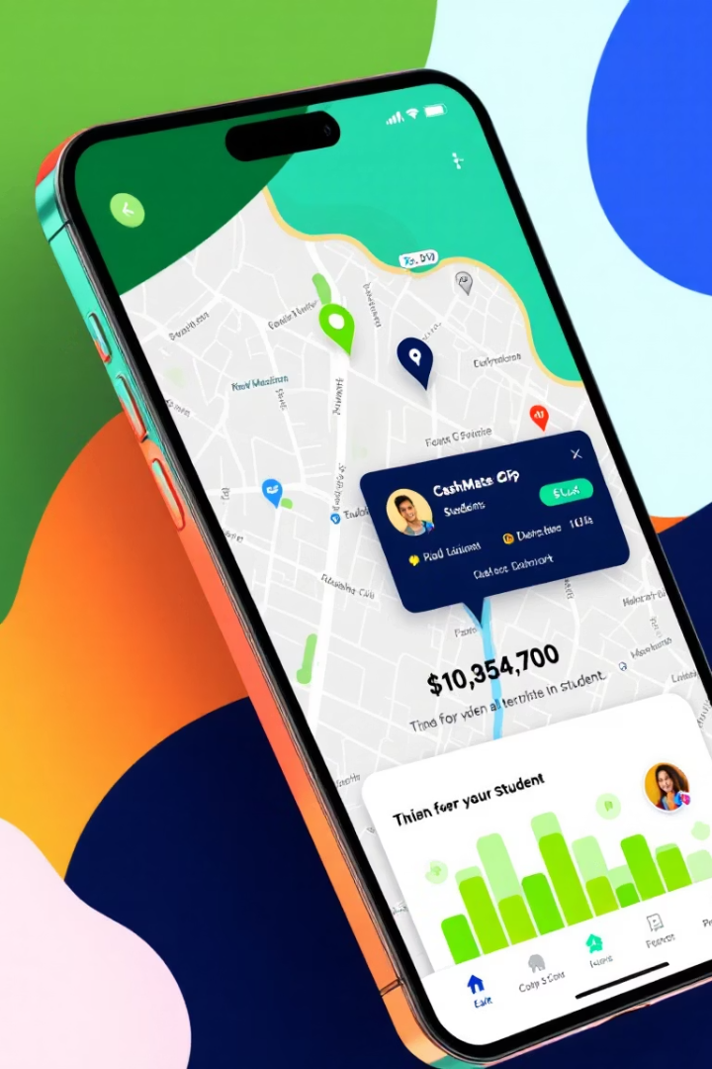
Introducing CashMate: Your Instant Money Solution
GPS Connectivity
Real-Time Requests
Connects students within a 3 km radius using precise location.
Post instant money needs to local peers for quick help.
Campus Cash Solution
82% of students agree CashMate ends the “no cash” problem.

Slide 4
Key Features: Seamless Transactions at Your Fingertips
Request Creation
Location Sharing
WhatsApp Exchange
Transaction Ratings
Specify amount, urgency, and reason clearly for each request.
Find nearby students for fast and easy meetups.
Opt-in to share phone numbers securely after connecting.
Build trust with a robust peer rating and feedback system.

Slide 5
Flexible Transfer Options: Cash or Online - Your Choice
Cash Transactions
Online Payments
Secure & Verified
Meet up safely to exchange physical cash quickly.
Supports Google Pay, PhonePe, and other popular apps.
All transfers are safe with user verification and monitoring.

Slide 6

How CashMate Works: Simple, Fast, and Reliable
Profile Setup
Download app and verify student ID quickly and securely.
Make Requests
Post or browse money requests near you within seconds.
Connect & Exchange
Agree on terms, meet or transfer money promptly.
Rate & Build Trust
Provide feedback to strengthen community reputation.

Slide 7








Benefits of CashMate: More Than Just Money
Security
Community
Verified users ensure safe, trusted transactions.
Build networks through peer-to-peer money exchange.
Convenience
Savings
Instant access to cash or online payments anytime.
Avoid ATM fees and minimum online payment limits.

Slide 8
Join the CashMate Revolution!
Download Now
Easy Setup
Stay Connected
Scan & Get Started
Available on iOS and Android devices.
Quick registration with student ID verification.
Follow @CashMateApp on social media for updates.
Use the QR code to join the CashMate community today.

